Slide 1
Case Study 4 - Crime Data Analysis
TEAM 03

Slide 2


Objective
To develop a model based on the crime data
Provide insights about data
Help the authorities to make effective decision
Implement effective strategy to keep the city safe and evolve as a smart city

Slide 3
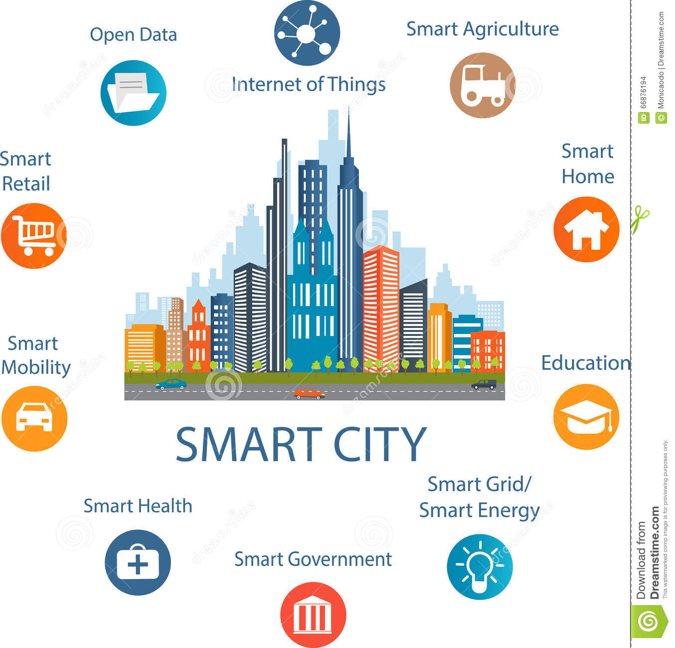
Smart City
To integrate multiple information and communication technology (ICT) and Internet of Things (IoT) solutions in a secure fashion to manage a city's assets.
Goal of a Smart city: Improve quality of life by using urban informatics and technology to improve the efficiency of services and meet residents' needs.

Slide 4

Crime Data Analysis
Crime data analysis is fundamental to effective crime prevention.
Knowing as much as you can about crime will help significantly in its prevention
Determining if particular crimes are increasing
Identifying the hot spot locations where crime is concentrated

Slide 5

Crime Data Analysis -How it helps ?
Enables city authorities to detect areas of increased crime.
Opportunity to act proactively and deploy officers more intelligently.
For law enforcement authorities- Higher rate of detecting crime, automatic detection of crime, better responsiveness to it, more efficient operations, optimizing budget, etc.
For cities: Less crime, more attractive for investors, companies and human resources, etc.
For residents: Safer neighborhoods, faster access to safety information etc.

Slide 6
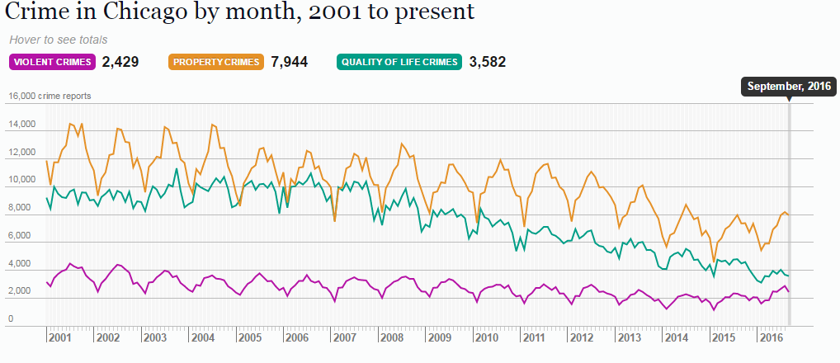
Why Chicago ?

Slide 7
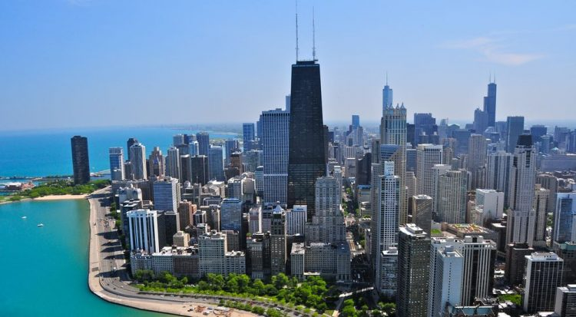

Data Set
Our major source of crime data for city of Chicago was from https://data.cityofchicago.org/.
Few other datasets were:
Police data of city of Chicago
Real Estate data for city of Chicago
School dataset

Slide 8
Data Description
Crime by Time
Crime by Type
Crime by Location

Slide 9
Data Set
Dataset Size:
Total Records 6,193,548 (2001 - 2016)
Variables : 21
Training Set
2001-2005
Test Set
2016

Slide 10

Logistic Regression
Logistic Regression:
The logistic regression is applied on the attributes ‘Primary Type’ and ‘IUCR’.
Our model was fit and the percentage of correctly classified instances is 86.91%.

Slide 11
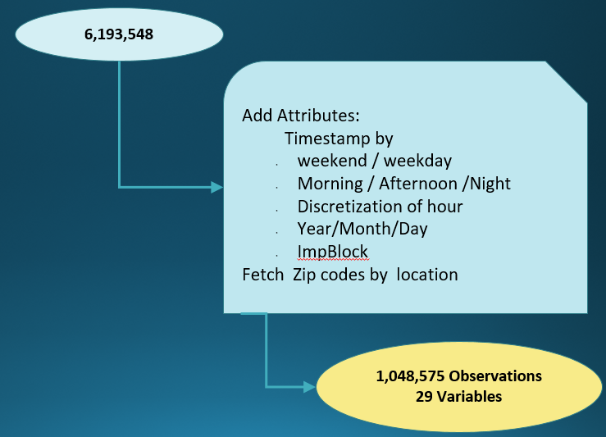
Data Description
Restaurant Rating Data Set from Yelp!
Based on latitude and longitude

Slide 12
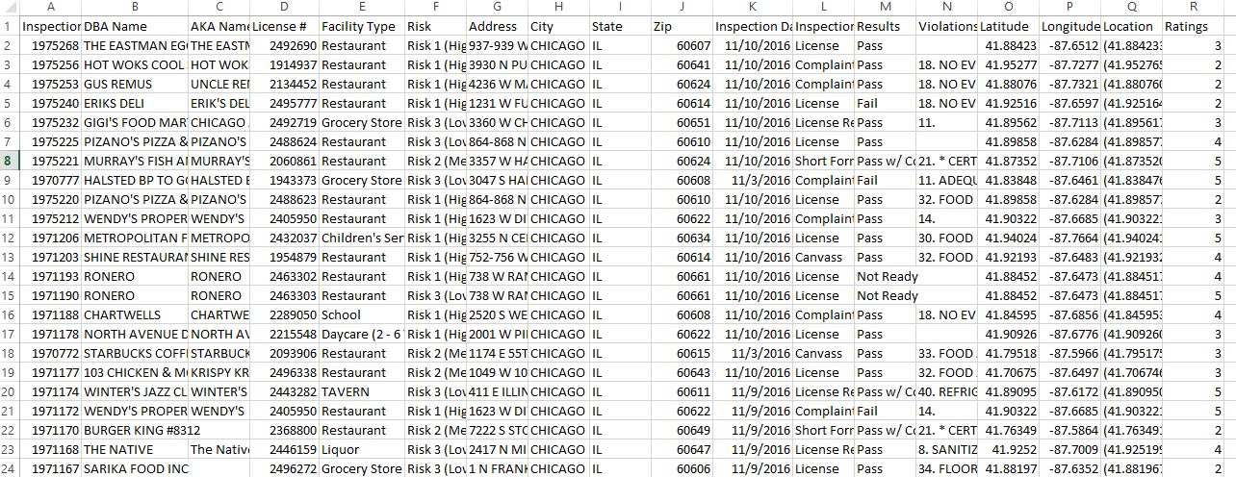
Data Description

Slide 13
Data Description
Used the Time Stamp Column
Used to create new Month, Date, Time columns
Split to create Morning, Evening and Night
Extracted zipcode using ipython geolocator

Slide 14
Dashboard

Slide 15
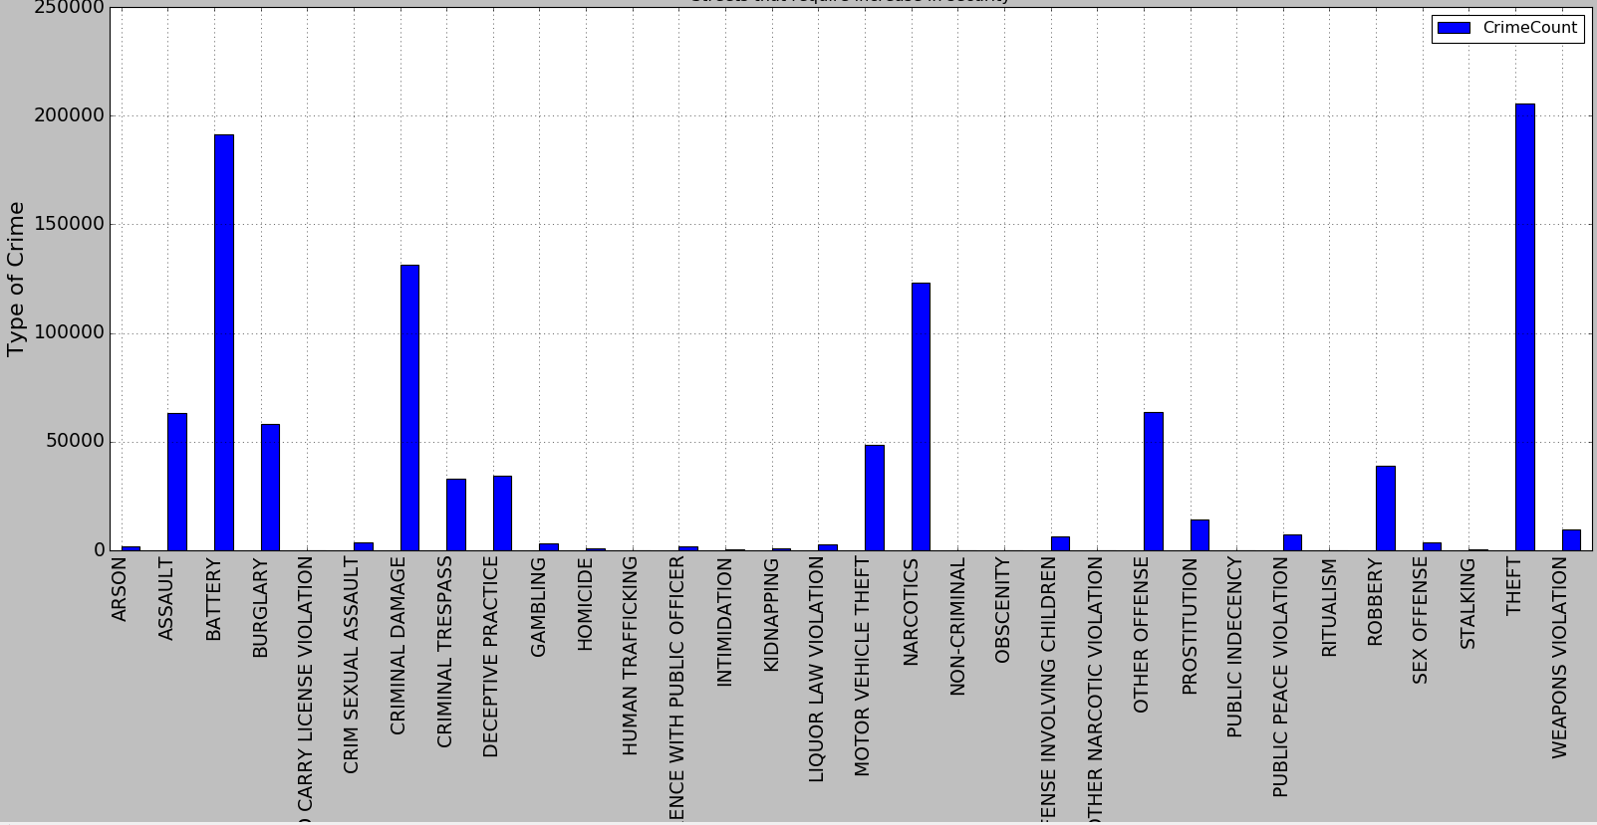
Distribution by Crime Type

Slide 16
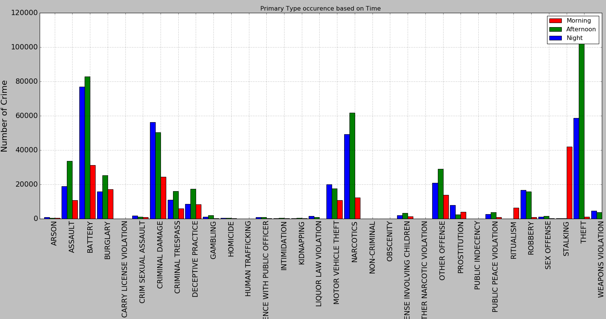
Crime type by time

Slide 17
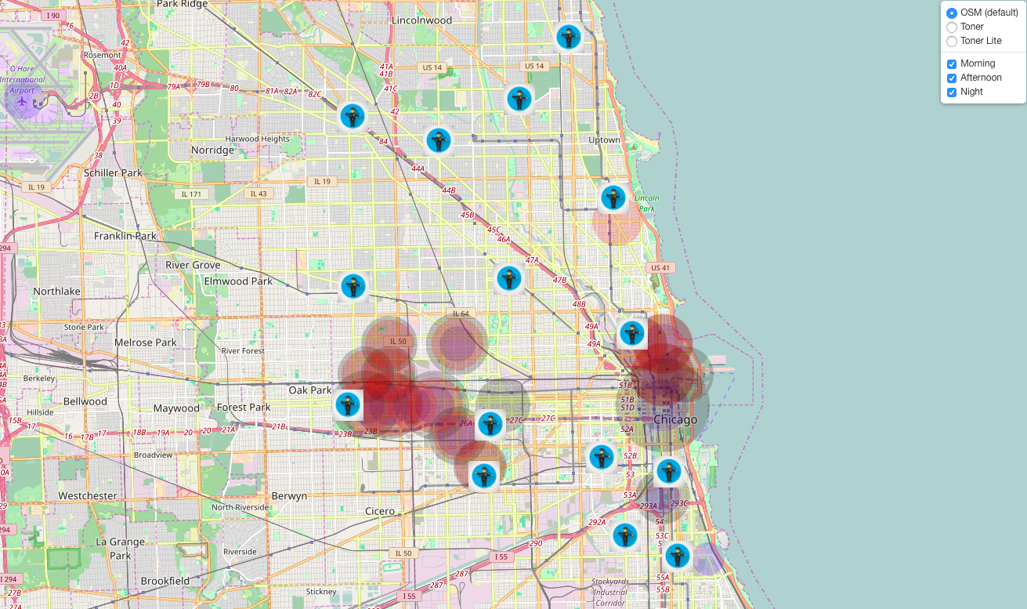
MAP

Slide 18
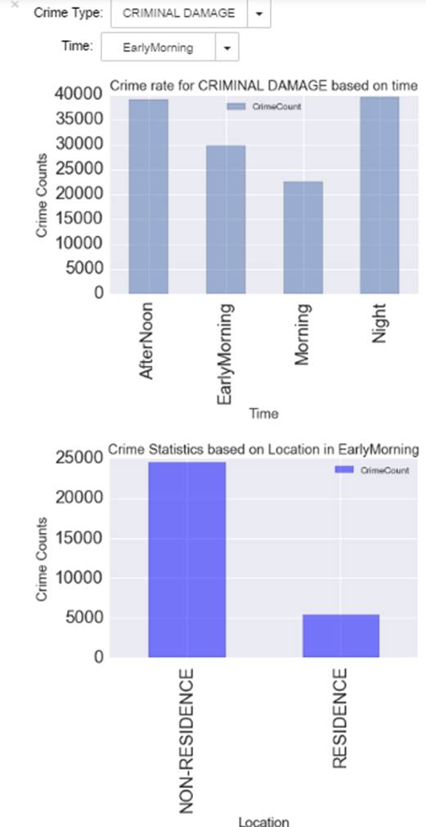
UI

Slide 19
Conclusion
This Model helps in
Identifying locations that require attention
Suggesting additional police force deployment in more susceptible areas during vulnerable hours.
Help decrease the crime rate

